Slide 1
Report on the Belle II Data Handling Group
August 18~20, 2010
Q2C workshop, Yangyang, Korea
Kihyeon Cho
(As a chair, on behalf of the Belle II DH Group)
High Energy Physics Team
KISTI (Korea Institute of Science and Technology Information)

Slide 2
Contents
HEP team @ KISTI
Belle vs. Belle II
Status and Plan of Belle II DH Group
Products
Summary

Slide 3
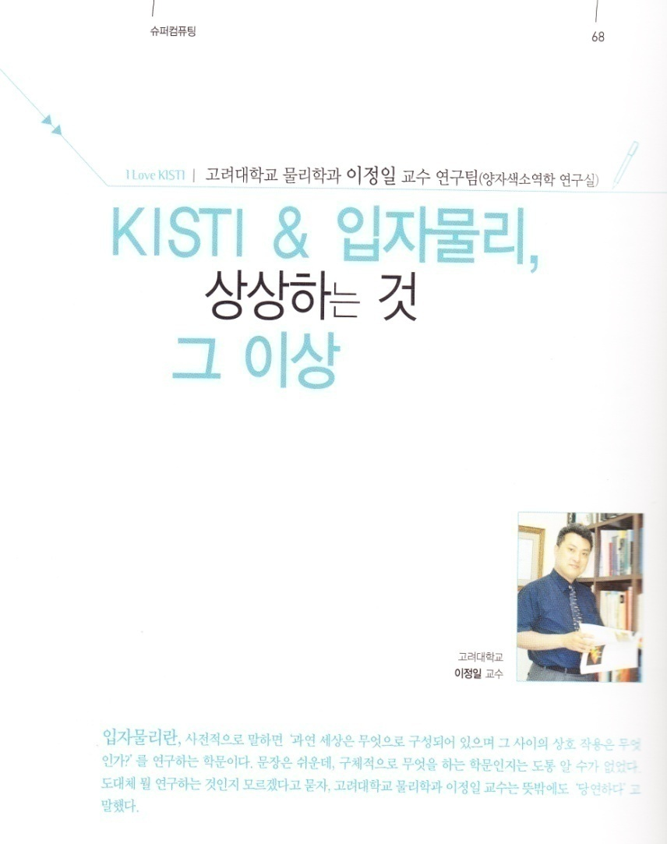
High Energy Physics Team @ KISTI
High Energy Physics Team (Physicists)
Kihyeon Cho – P.I.
Soo-Hyeon Nam - Senior Researcher
Junghyun Kim - Senior Researcher
YoungJin Kim - Postdoc
Jihye Moon - Researcher
Onbitnuri Kim - Intern Student (KAIST)
Seok Hoon Yun - Intern Student (KAIST)
Byungsoo Yoo – Intern Student (GSNU)
Former member
Yongseok Oh – Prof. of Physics @ KNU
Daejung Kong - Contract Prof. @ KNU
Ilsung Cho - Contract Prof. @ KyungHee U.
Minho Jeung - Company
Hyunwoo Kim - Computing Team @ KISTI

Slide 4
High Energy Physics Team @ KISTI
To probe the Standard Model and search for New Physics
e-Science
Comput-ing
Experi-ment
Theory
CDF
Belle/Belle II
Heavy Flavor Physics
Notes:
Wednesday, Landau shows similar diagram. According to Tony Hey, the 21st century is for data centric science called e-Science to unify theory, experiment and computing. We apply this concept to collider physics.
The goal is to probe SM and search for new physics. We focus on charm, bottom, top and Higgs.

Slide 5
Belle vs. Belle II
Belle | Content | Belle II
1998~2010 | Time Schedule | 2014~
1 ab⁻¹ | Luminosity | 50 ab⁻¹
1 Billion | BBbar events | 50 Billion
CP measurement | Goal | New Physics
Belle II
Belle

Slide 6
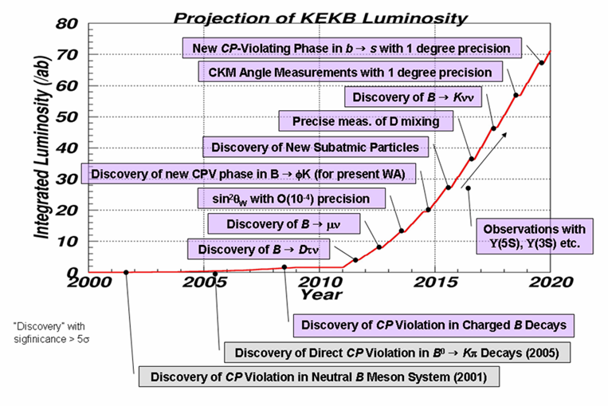
Luminosity vs. Physics
Major achievements Expected at Super B Factory
Start 2012 => 2014

Slide 7
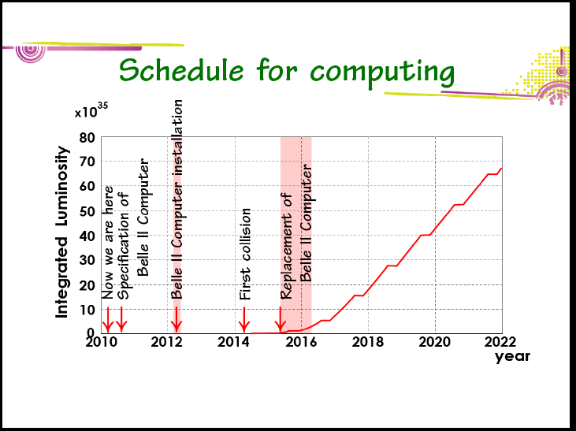
Belle II Time schedule
Hara San

Slide 8
2014 April – Collider turn on
2012 February – Ready for Computing
2011 Summer – Rough final system
2010 Summer – Prototype system
Spec & Test
2010.5 PAC – Answers for questions
Computing & Pixel

Slide 9
Belle II Computing
=> To handle data, we need new data handling system.

Slide 10
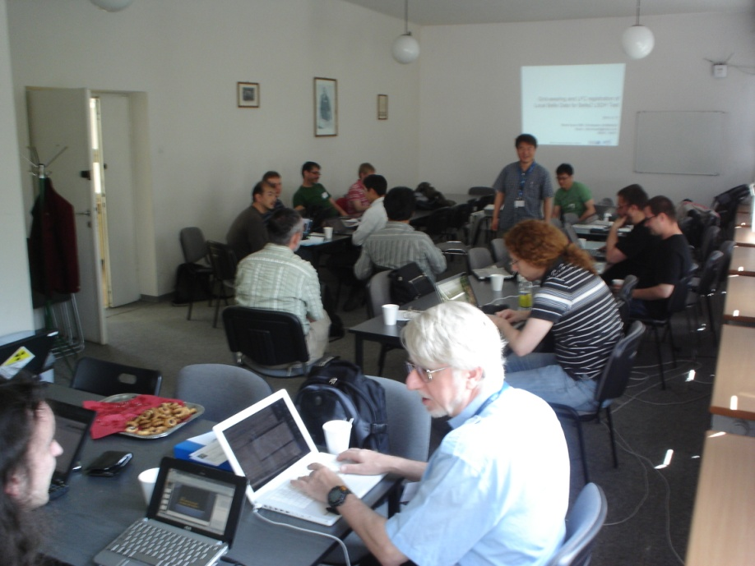
Belle II Data Handling Group (Chair: Kihyeon Cho)
KISTI Group
HEP Team
– JungHyun Kim, Kihyeon Cho,
YoungJin Kim, …
AMGA Team
– Soonwook Hwang, Sunil Ahn,
HanGi Kim, Tae-sang Huh, …
Melbourne Group
Tom Fifield, Martin Sevior, …
Krokow Group
Maciej Sitarz, Mitosz Zdybat, Rafat Grzymkowski, Henryk Polka, …
KEK, Karlsruhe, etc…

Slide 11
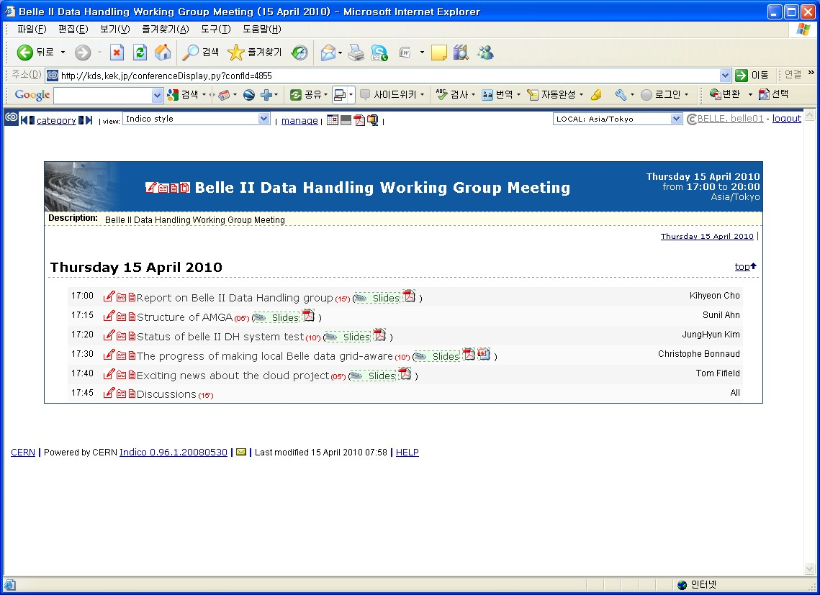
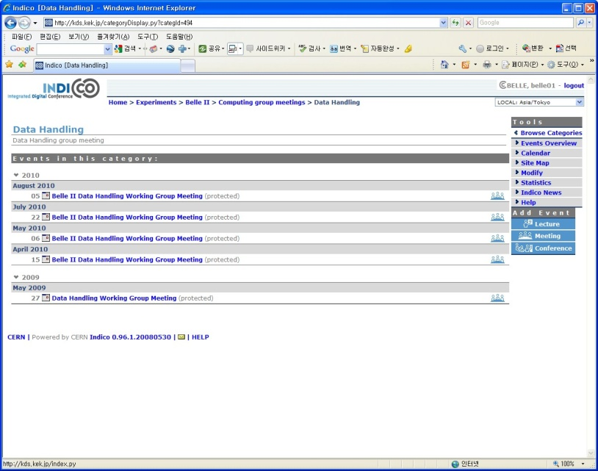
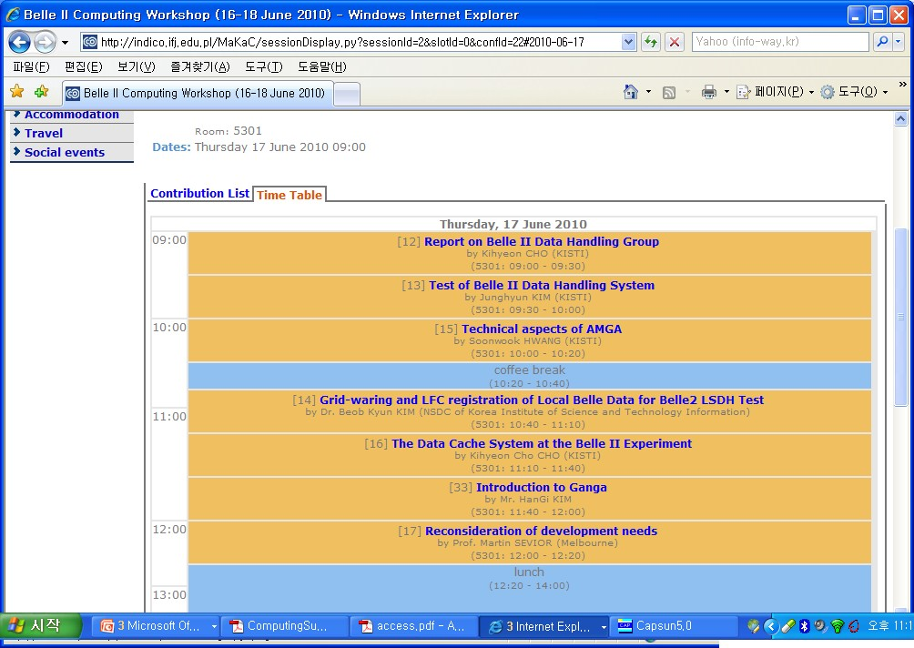
Belle II Data Handling Group meeting
First and Third Thursday 5:00 PM (KEK Time)

Slide 12
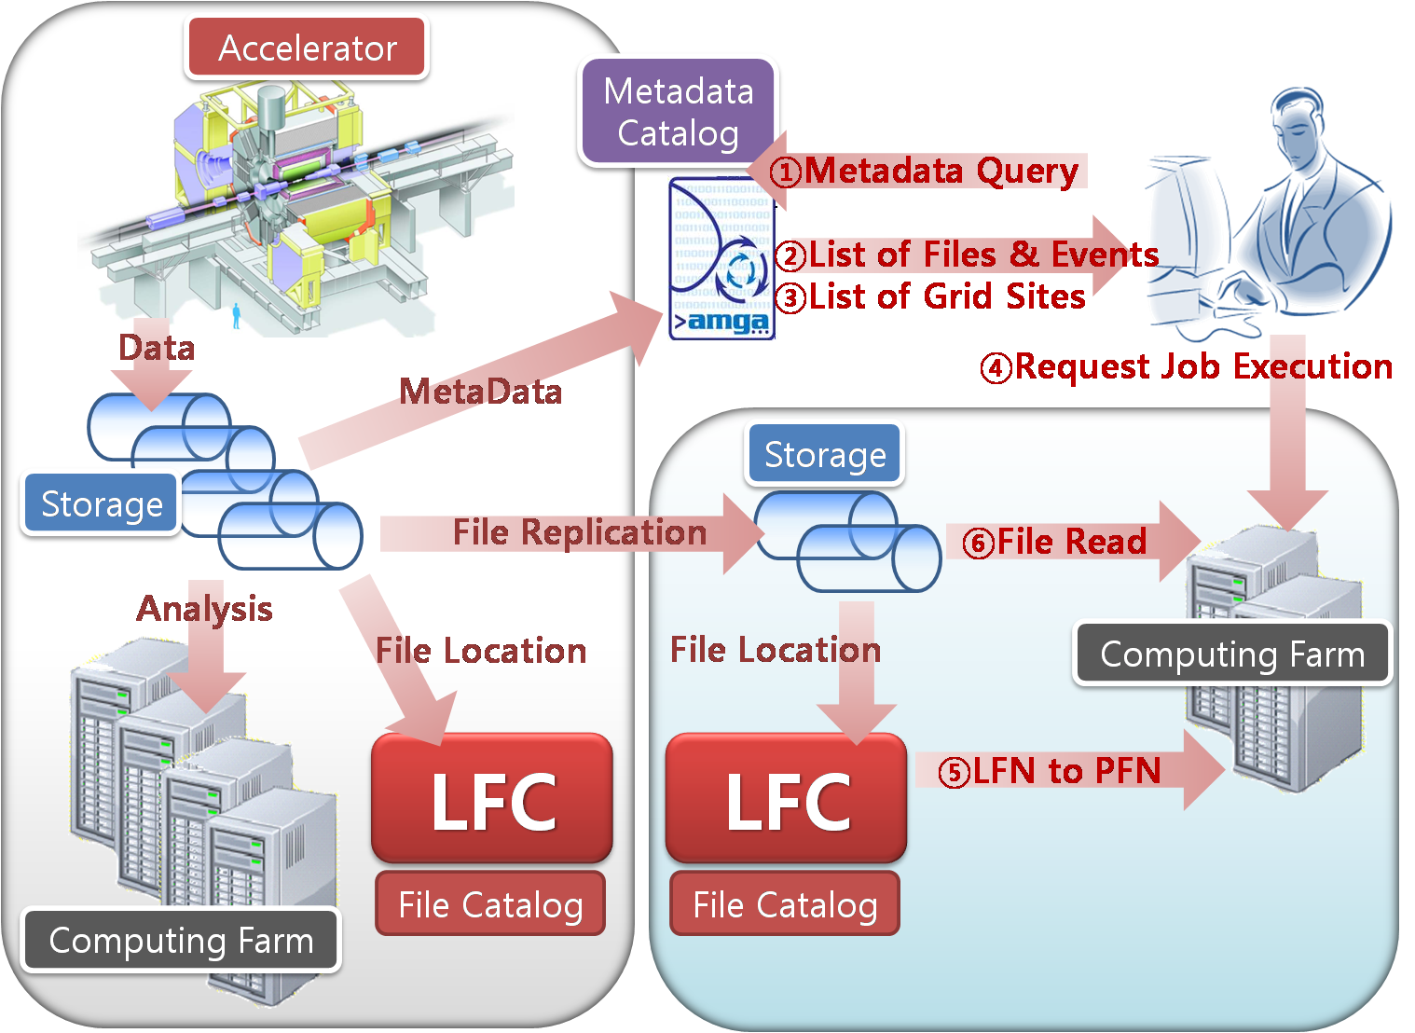
Data Handling Outlines
KISTI
KEK, Tier0 sites
Tier1 sites

Slide 13
Status and Plan of Belle II DH Group
To construct Belle II Data Handling System
Meta-data system, data cache system, …
To test Large Scale Data Handling
Belle Data at KISTI
Belle II Data (Random data) => doing
Belle Data at KEK => will do
To apply AMGA at HLT => will do
Data Handling and Job Management for Belle II Grid
Interactive Grid Console
Data Handling -> FTS

Slide 14
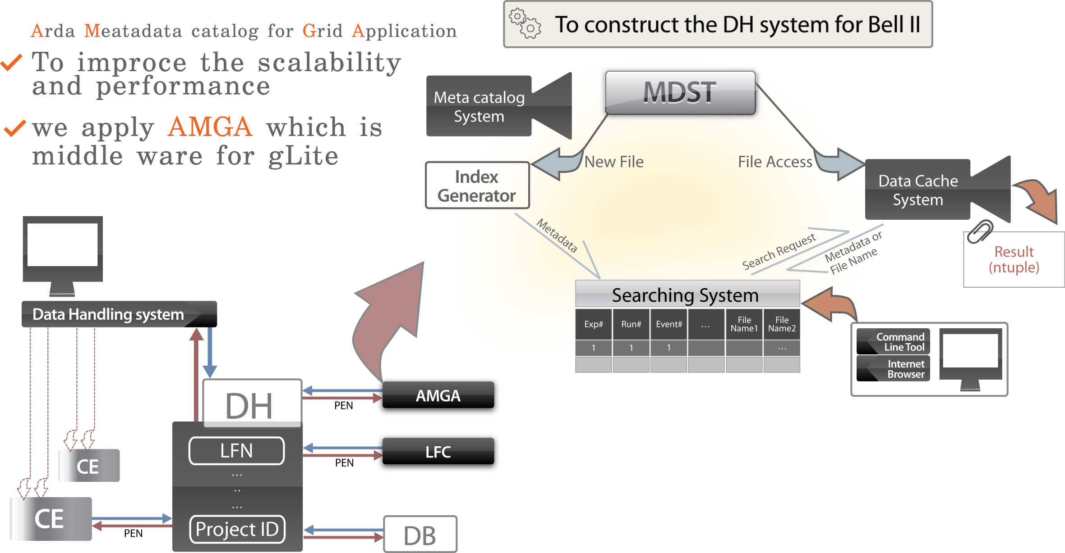
Belle II metadata system
To construct the DH system for Belle II experiment
To improve the scalability and performance
To run based on grid farm
⇒ AMGA (Arda Metadata Catalog for Grid Application)
Data Cache
AMGA

Slide 15
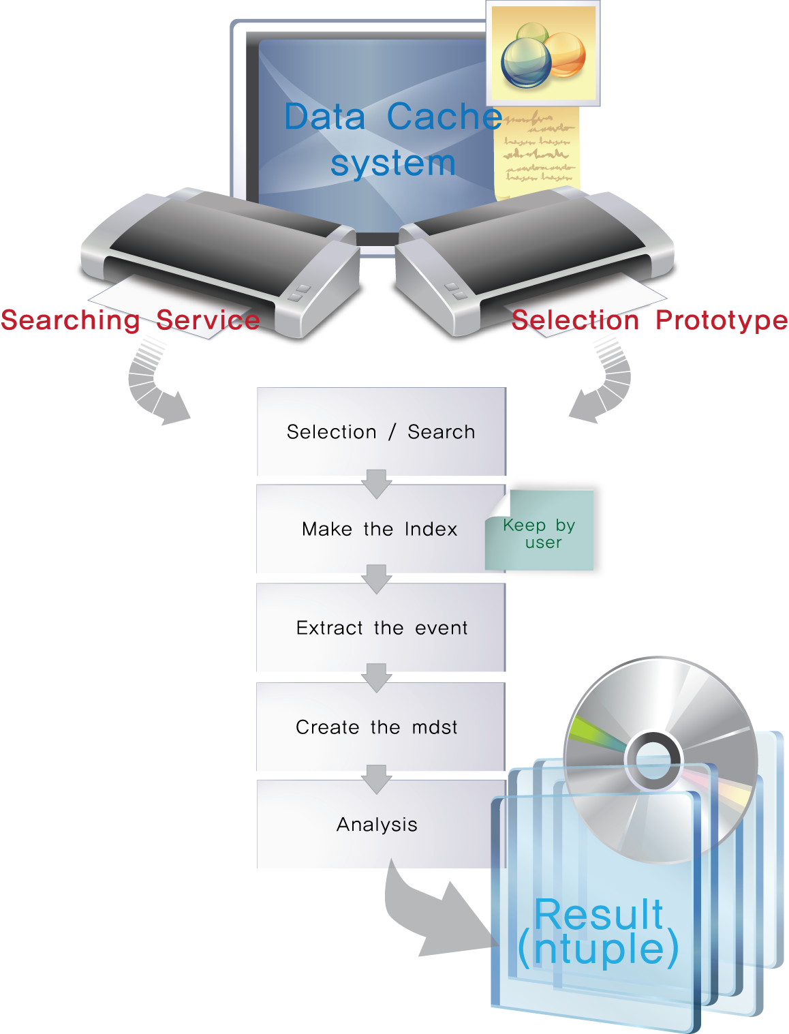
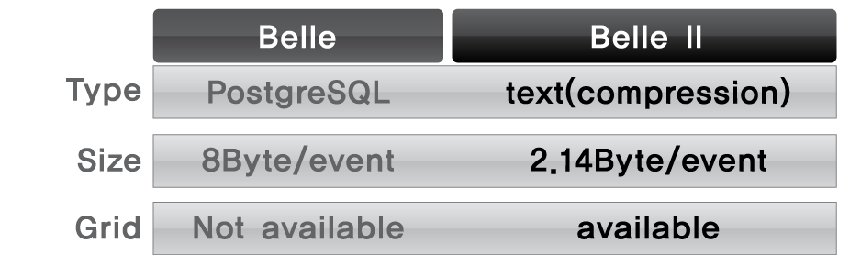
Belle II data cache system
We make the simple data tool
which is not based on database.

Slide 16
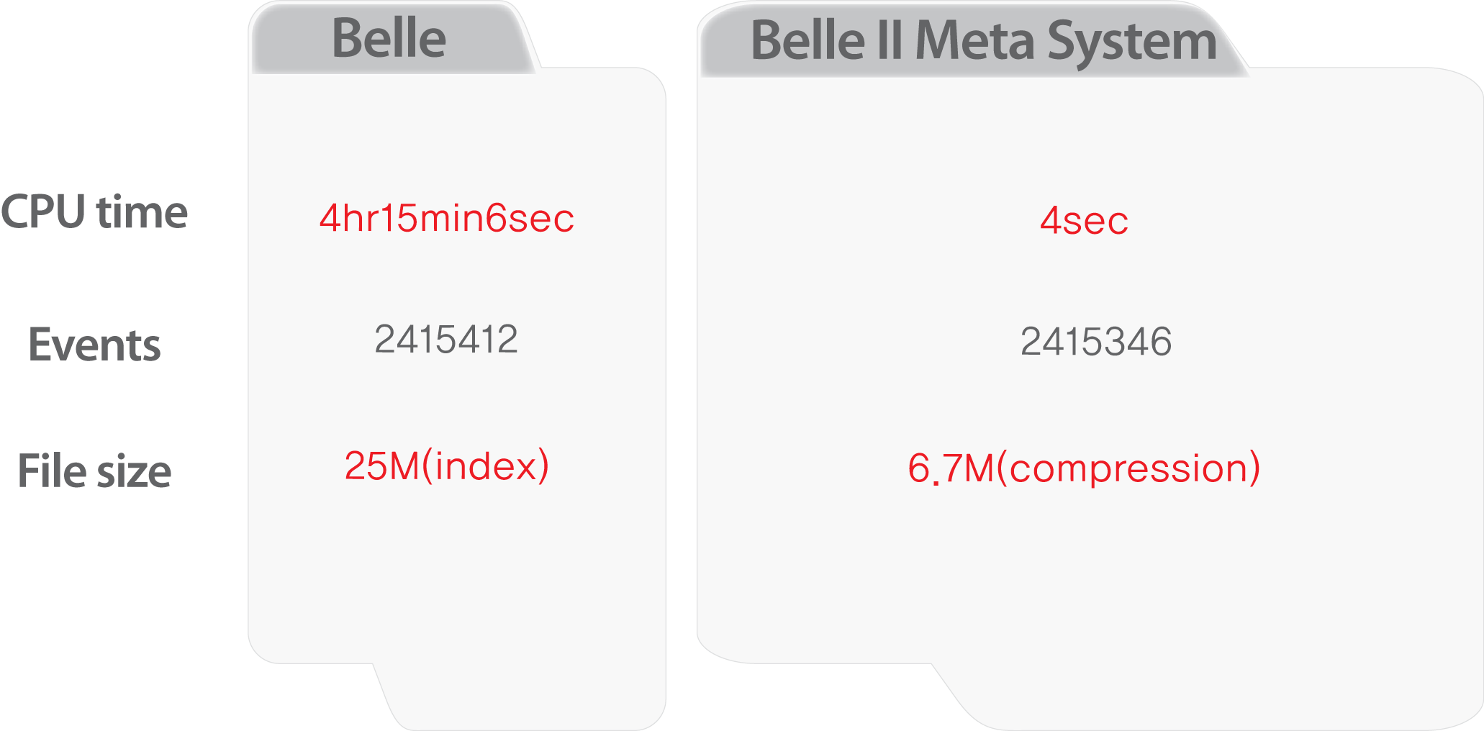
Belle II data cache system
(Byte)

Slide 17
Performance Test
File-level metadata searching
We show reasonable response time even in the worst-case that the number of concurrent queries reaches 50.
Average Response time on the worst-case query of file-level metadata searching

Slide 18
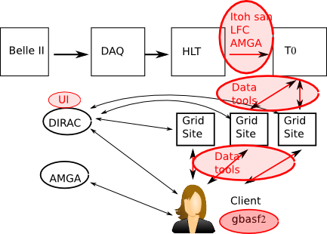
The interface between HLT and T0
=> To apply AMGA
Itoh San

Slide 19
Data Handling and Job Management for Belle II Grid
Poland Group

Slide 20
Data Handling and Job Management for Belle II Grid
Poland Group

Slide 21
Products
Conference talks
The Advanced Data Searching System with AMGA at the Belle II Experiment
J. H. Kim
CCP2009, Gaushung, Taiwan, Dec., 2009
Data Cache System at Belle II experiment
K. Cho
CCP2010, Trondheim, Norway, June 2010
Belle II Data Management system
K. Cho
CHEP 2010, Taipei, Taiwan, Nov. 2010
Accepted as an oral talk

Slide 22
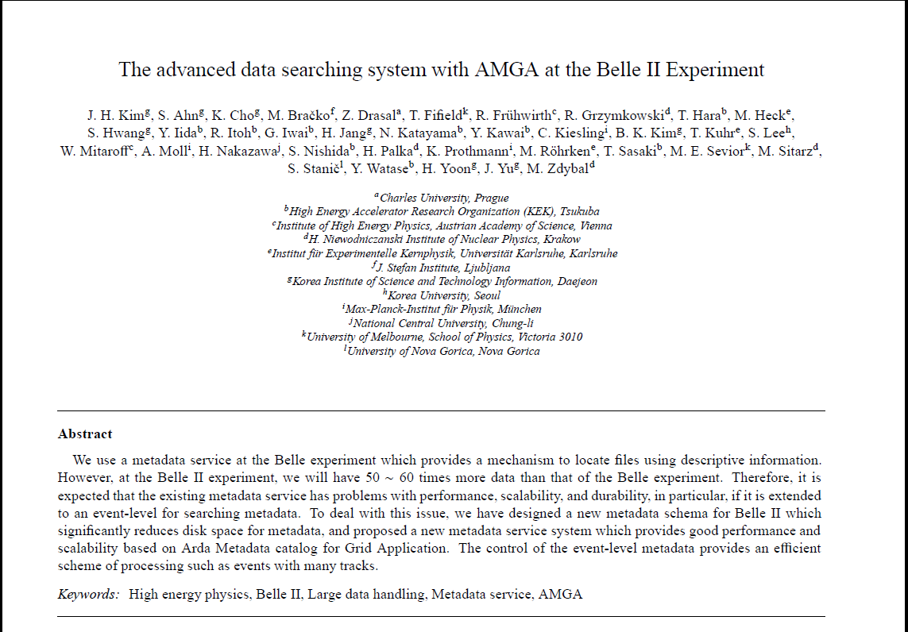
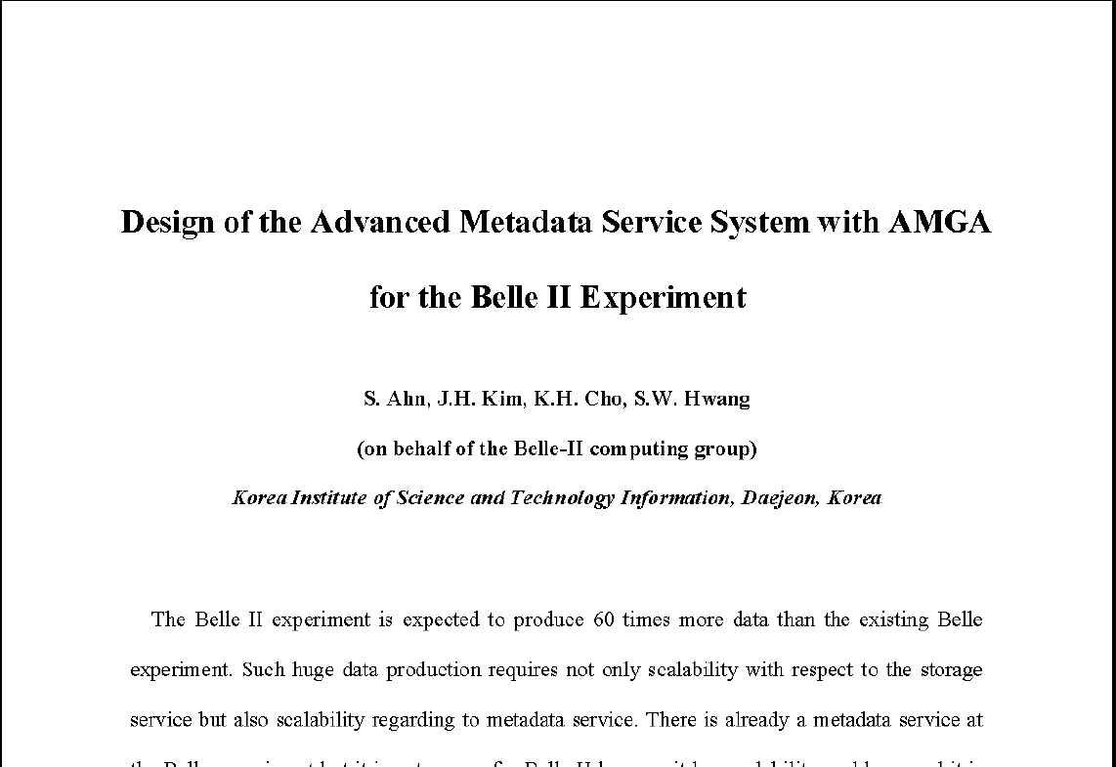
Products - Papers
S. Ahn, K.Cho, S.W.Hwang, J.Kim* et al, submitted to JKPS
J. H. Kim, S. Ahn, K.Cho*, et al, CPC (2010.08)

Slide 23
Belle II DH Group – Daeduk net (2010.4.6)
http://www.hellodd.com

Slide 24
Summary
In order to handle 50 times more data of Belle,
Belle II Data Handling Group works on:
Metadata system and data cache system based on Grids
Test of Large Scale Data Handling
Belle II Data
Belle Data at KEK
Application of AMGA at HLT
Data Handling and Job Management for Belle II Grid
This is a great success!
Keep going

Slide 25
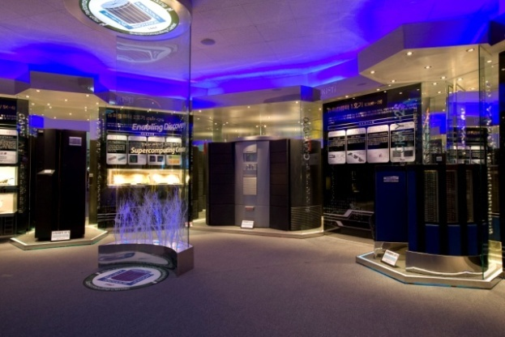
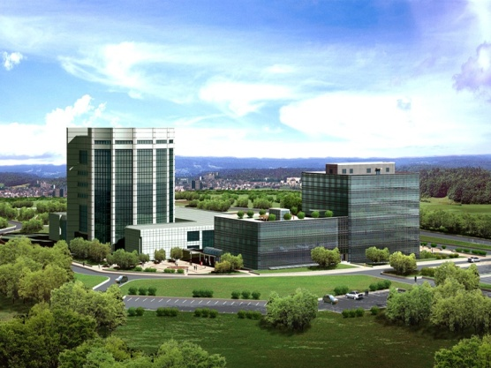
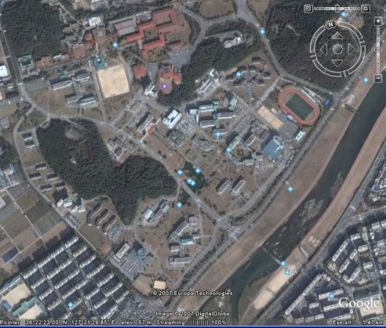
The 3rd Belle II Computing Workshop
Date: November 22-24 (Mon-Wed.) 2010
1st day (Monday): Off-line and HLT software
2nd day (Tuesday): Distributed Computing and Data Handling
3rd day (Wednesday)
Morning – Overflow
Afternoon- Excursion
Place: KISTI, Daejeon, Korea
As a chair of Belle II DH group, HEP team@ KISTI hosts
Just after Belle II General Meeting @KEK, on Nov. 17-20

Slide 26
Thank you.
cho@kisti.re.kr

