Slide 1
Belle II
Data Management System
October 18~22, 2010
CHEP 2010, Academia Sinica, Taipei, Taiwan
Junghyun Kim, Sunil Ahn and Kihyeon Cho*
(on behalf of the Belle II Computing Group)
*Presenter
High Energy Physics Team
KISTI (Korea Institute of Science and Technology Information)

Slide 2
Contents
Belle II Experiment
Belle II Data Handling System
  Meta-data system
  Data cache system
  To test Large Scale Data Handling
    With Belle Data
    With Belle II Data (Random data)
The interaction between HLT and Storage
Summary

Slide 3



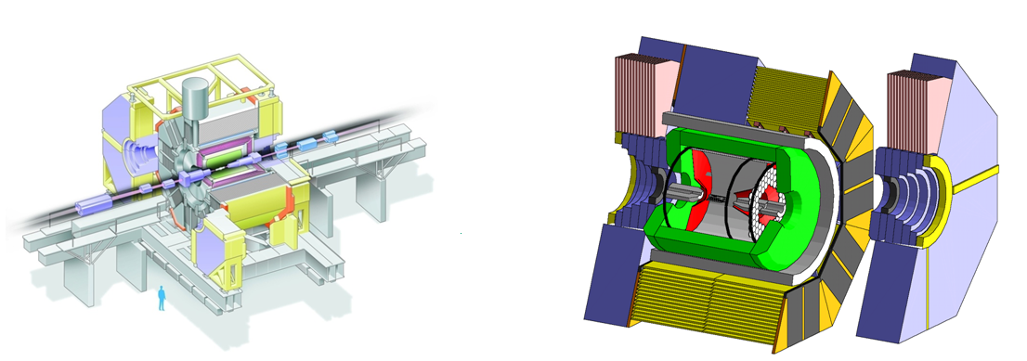
Belle vs. Belle II
Belle | Content | Belle II
1998~2010 | Time Schedule | 2014~
1 ab⁻¹ | Luminosity | 50 ab⁻¹
1 Billion | events | 50 Billion
CP measurement | Goal | New Physics
Belle II
To handle 50 times more data and to use grids
⇒ New data handling system
Belle

Slide 4
Belle II computing model
Raw Data Storage
And Processing
Tape
Raw Data
CPU
mDST Data
Disk
mDST MC
KEK
AMGA
Ntuples
Client
UI
Data Tools
gbast2
Data Tools
DIRAC
Data Tools
Data Tools
MC Production
(optional)
MC Production
And Ntuple
Production
Grid Site
Grid Site
Cloud
Ntuple
Analysis
Local Resources
Local Resources
Local Resources
Local Resources

Slide 5
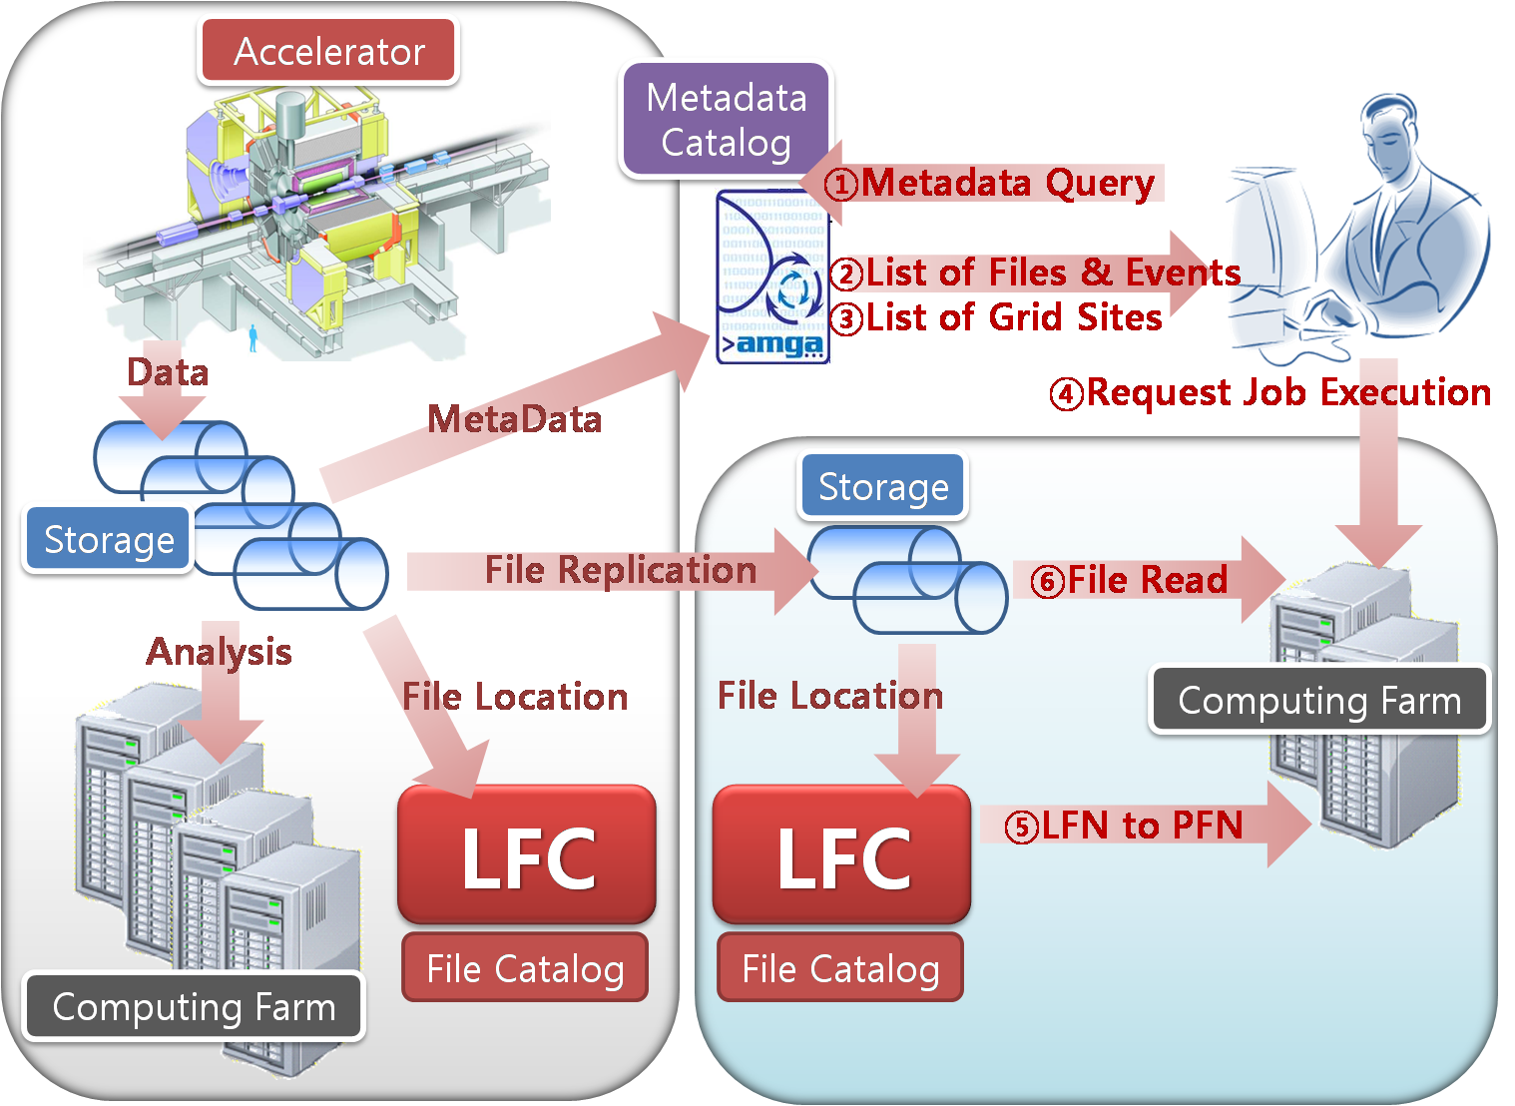
Data Handling Outlines
DIRAC
plan
KEK
Grid sites

Slide 6
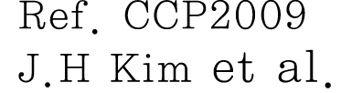
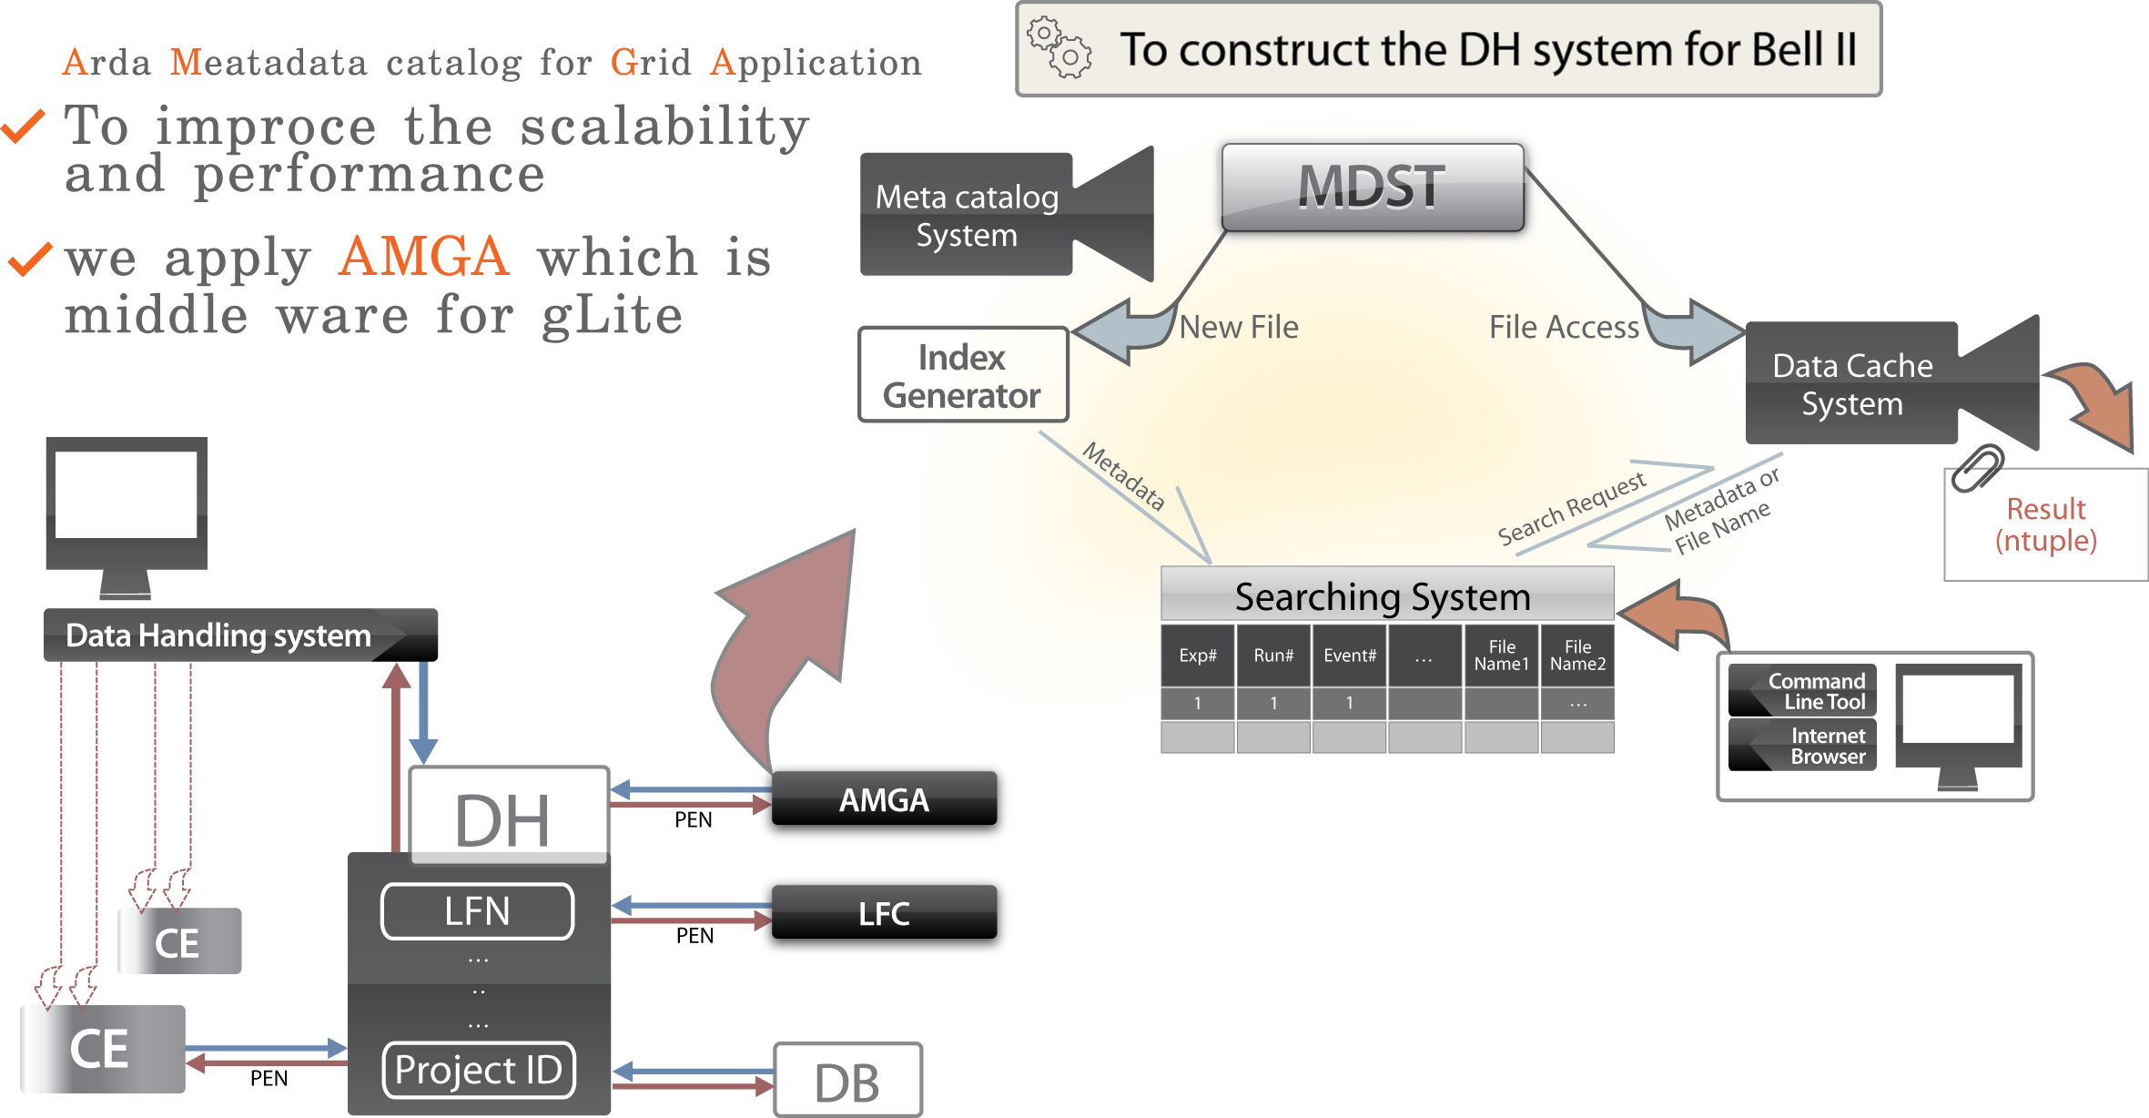
Belle II metadata system
To construct the DH system for Belle II experiment
To improve the scalability and performance
To run based on grid farm
⇒ AMGA (Arda Metadata Catalog for Grid Application)
Data Cache
AMGA
DIRAC
DIRAC

Slide 7
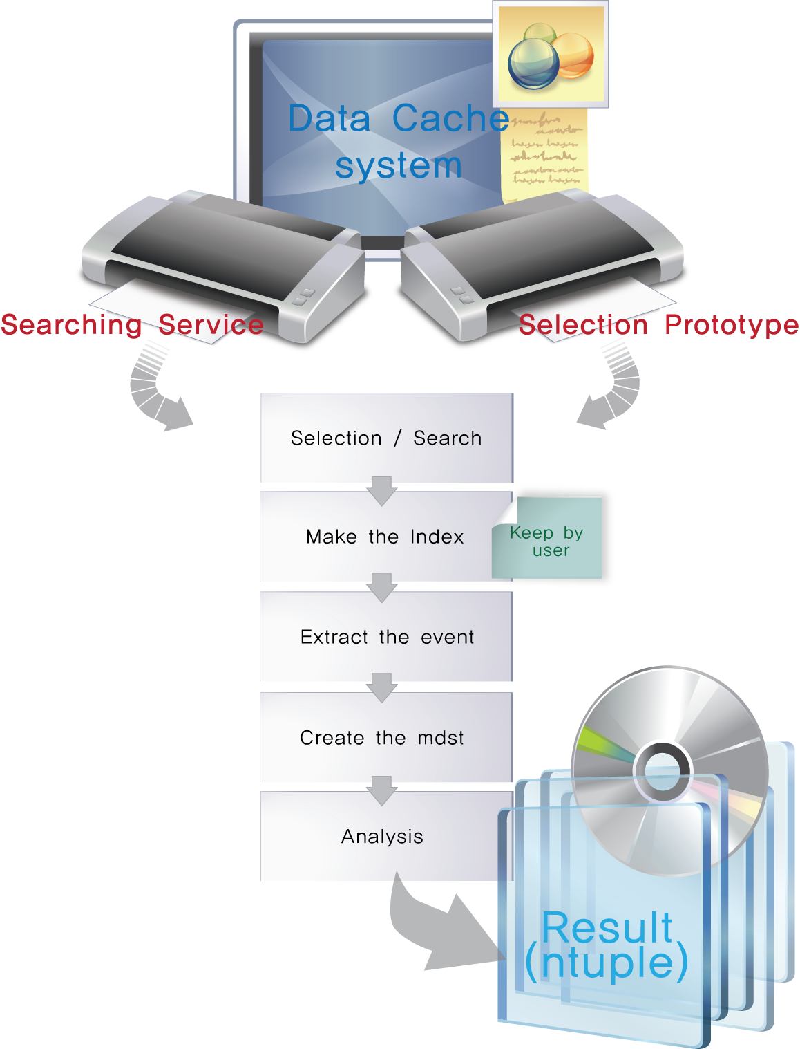
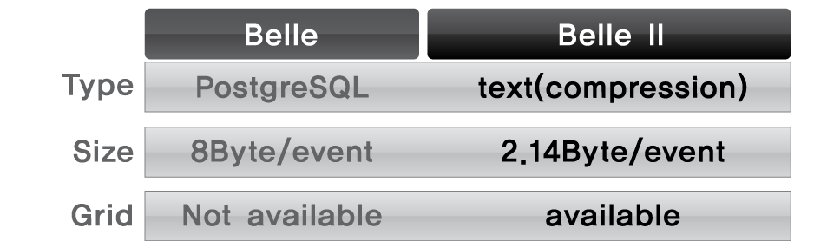
Belle II data cache system
We make the simple data tool
which is not based on database.
Event-driven meta-data catalog
⇒ Condition-driven meta-data catalog

Slide 8
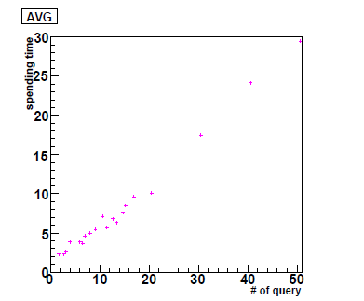
Large Scale data DH test with Belle Data
We perform searching for the interesting files with a table of meta-system and changing number of parallel processing.
The linearity of search is stable up to 50 parallel simultaneous processing.
Output
Input
# of files: 2013 files
# of events: 12 M events
# of luminosity: 5792 pb⁻¹
What queries?
  - run #, exp#, stream#...

Slide 9
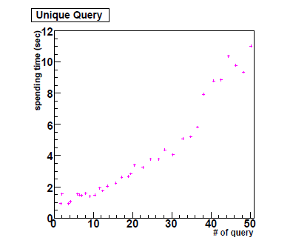

Large Scale data DH test with
Belle II Data (Random generating)
Input: 70,000 files (140TB)
The linearity of search is stable up to 50 parallel simultaneous processing.
It is almost same between using a table and using 30 multi-tables.
With a table and multi-processing
Generating time: 400 files/sec
With 30 multi-tables and multi-processing
Generating time: 400 files/sec

Slide 10
The interface between HLT and Storage
=> To apply AMGA
30kHz
Raw Data Storage
And Processing
Tape
Detector
CPU
Raw Data
Disk
mDST Data
6kHz
KEK
mDST MC
DAQ
AMGA
Ntuples
HLT
Client
UI
Data Tools
gbast2
LFC
AMGA
Data Tools
DIRAC
Data Tools
Data Tools
MC Production
(optional)
MC Production
And Ntuple
Production
Grid Site
Grid Site
Cloud
Ntuple
Analysis
Local Resources
Local Resources
Local Resources
Local Resources
We assume two files/sec for both reading and writing for AMGA.
Read-write optimization for meta-data
  Generating for writing only 400 files/sec
  To test reading performance for 1Hz, 2Hz, 10Hz, 50Hz and 100 Hz

Slide 11
Plan
DIRAC development env. ~ 1 month
Data registration with AMGA ~ 3 months
AMGA integration ~ 3 months
Data tools ~ 6 months
DAQ integration ~ 6 months

Slide 12
Summary
At the Belle II experiment, in order to handle 50 times more data of Belle, we have constructed Belle II Data Handling system based on grids.
We have tested the Large Scale DH with
  Belle Data
  Belle II Data (Random)
We are applying AMGA at HLT.
We are also integrating AMGA with DIRAC.

Slide 13
Thank you.
cho@kisti.re.kr

